Slide 1
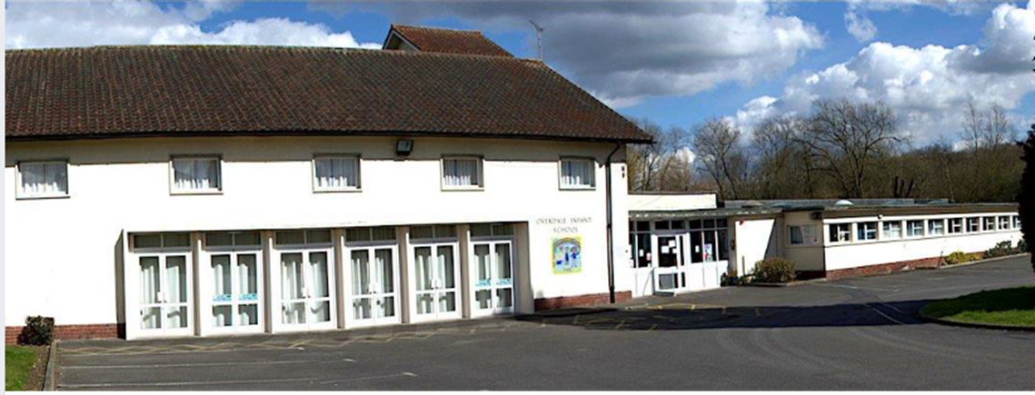
My Year 2 Book.

Slide 2
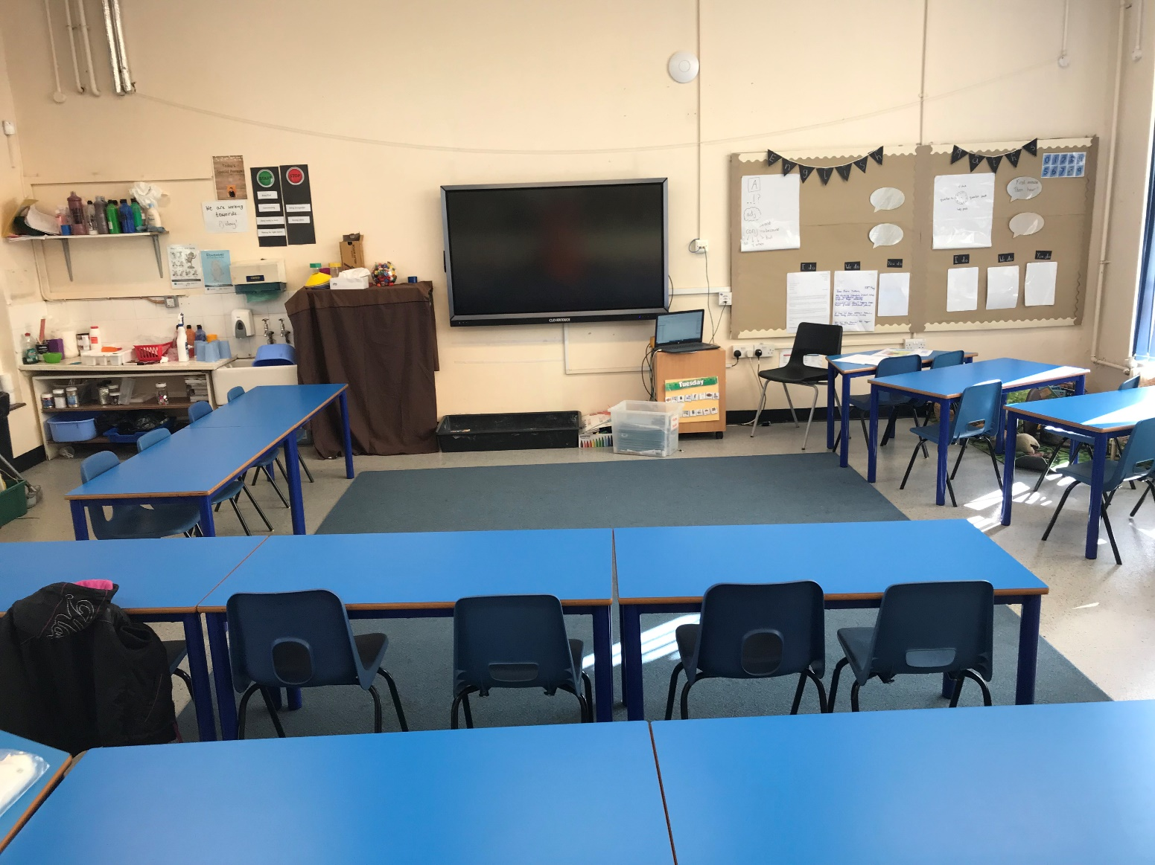
Orange Class will be your new class. It may look like this.

Slide 3
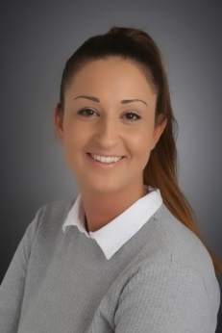
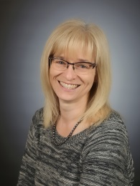
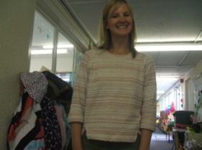
Miss Knezevic and Mrs Clayton will be your teachers.

Slide 4
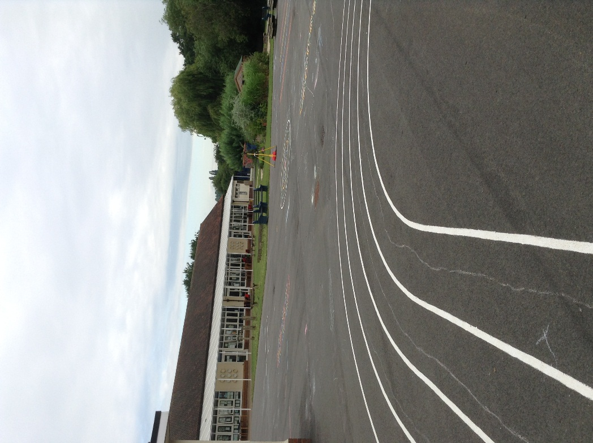
You will still use the big playground.

Slide 5
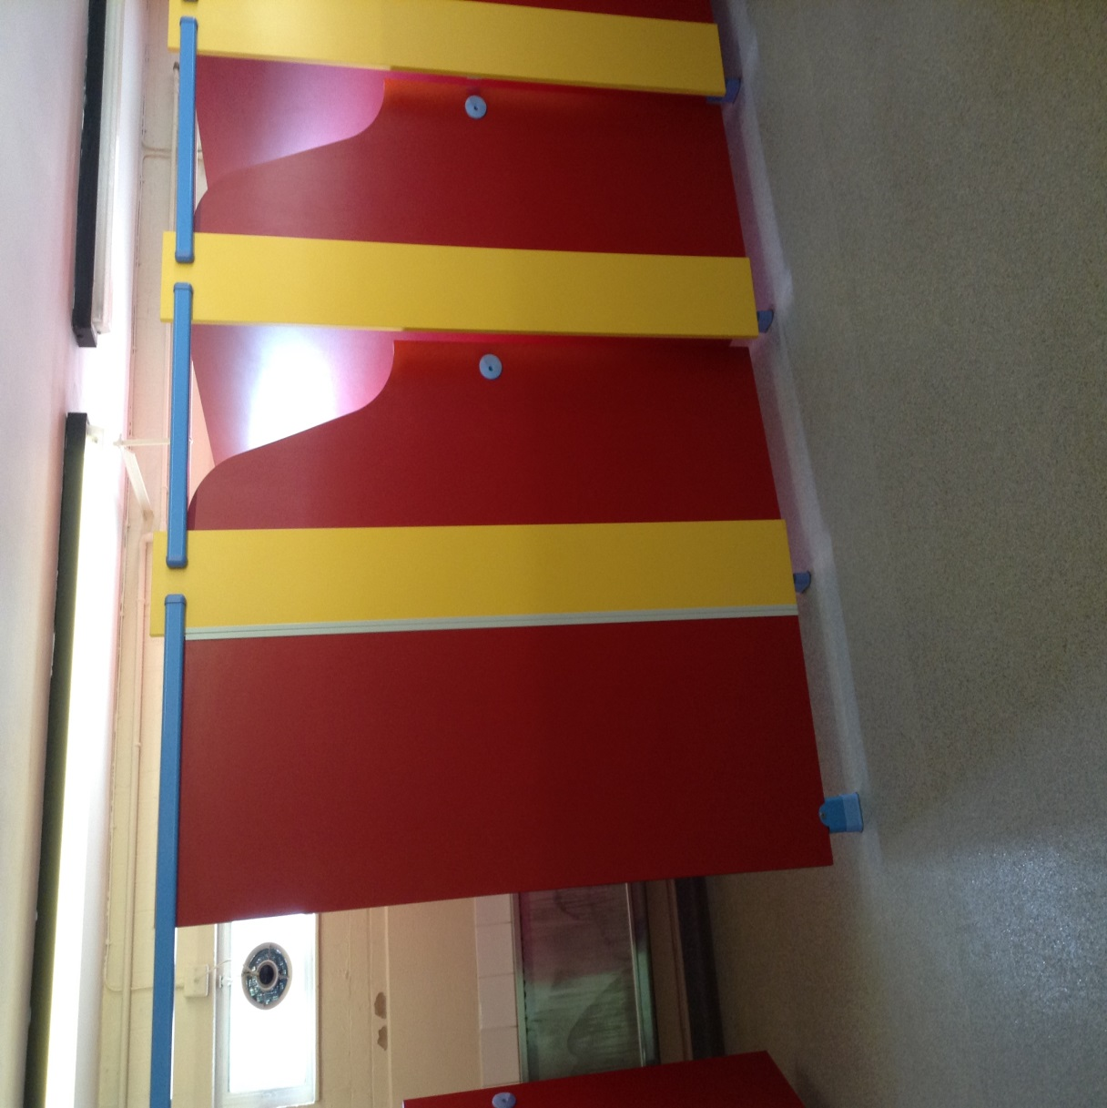
The toilets are next to Orange class.

Slide 6
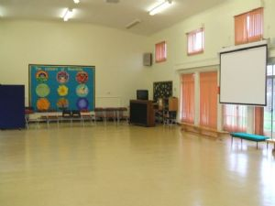
You may use the hall for PE and assemblies.

Slide 7
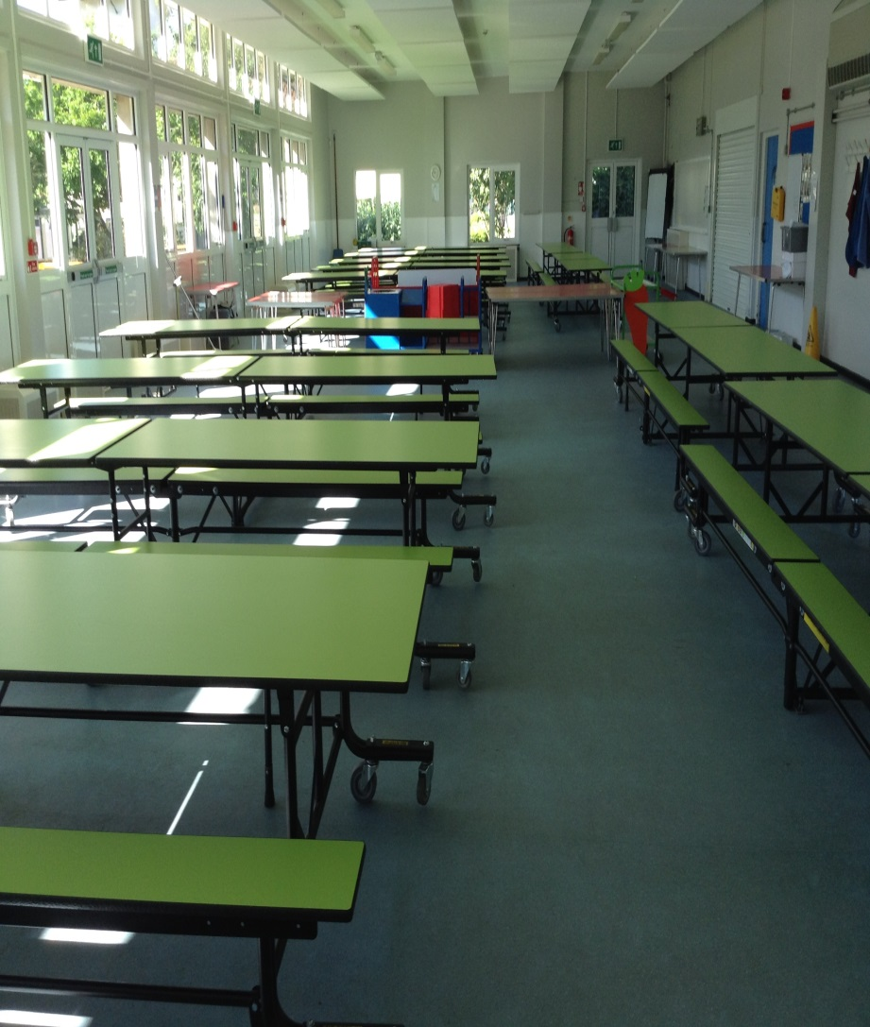
You may use the dining hall to eat your lunch.

Slide 8
Good luck in Year Two!

