Slide 1
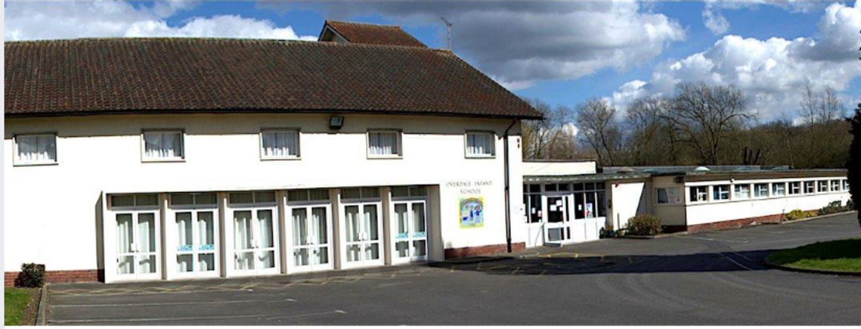
My Year 1 Book.

Slide 2
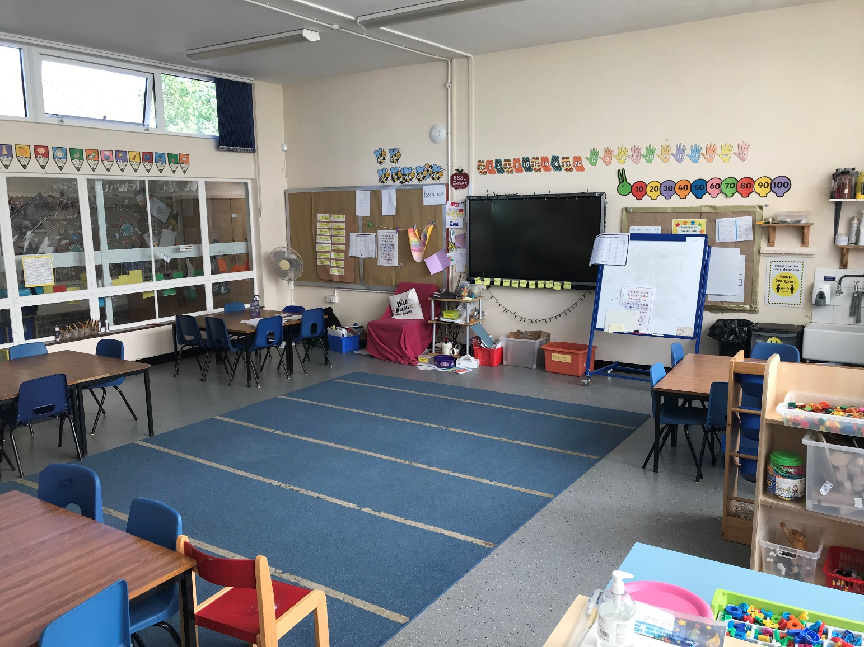
Green Class will be your new class. It may look like this

Slide 3
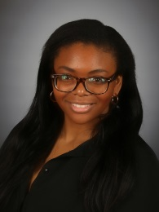
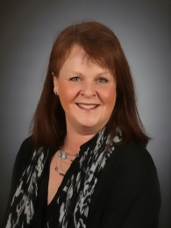
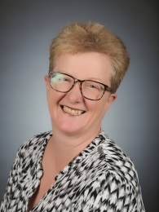
Miss Francis, Mrs Taylor and Mrs Smith will be your teachers.

Slide 4
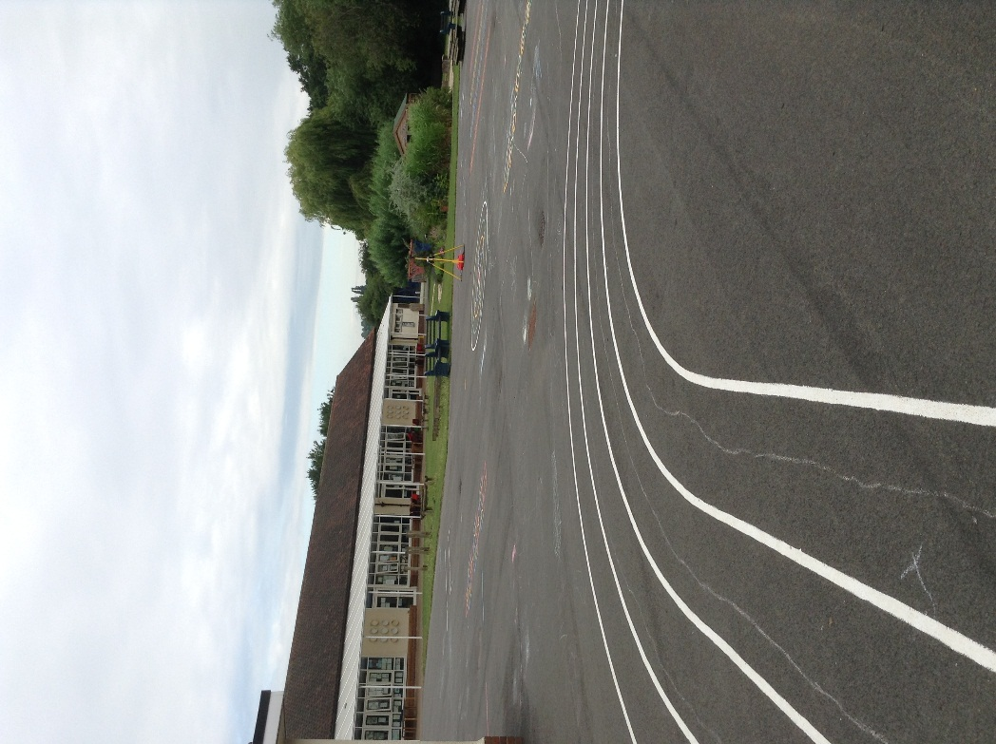
You will use the big playground.

Slide 5
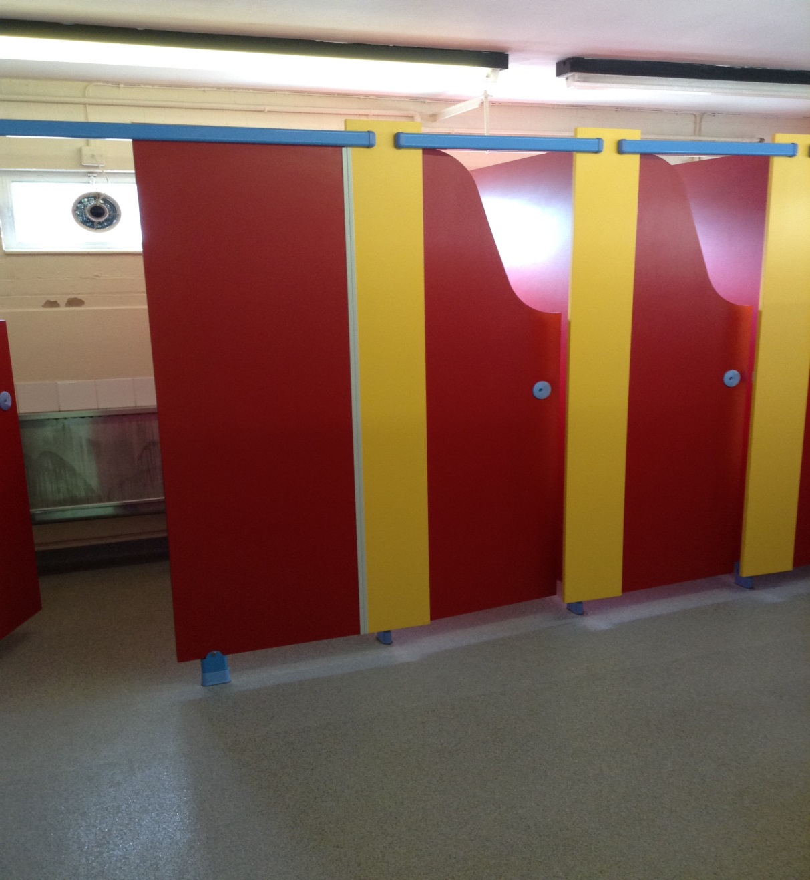
The toilets are next to Indigo class.

Slide 6
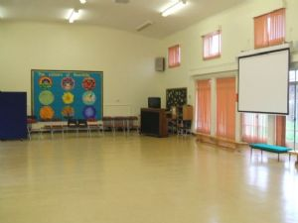
You may use the hall for PE and assemblies.

Slide 7
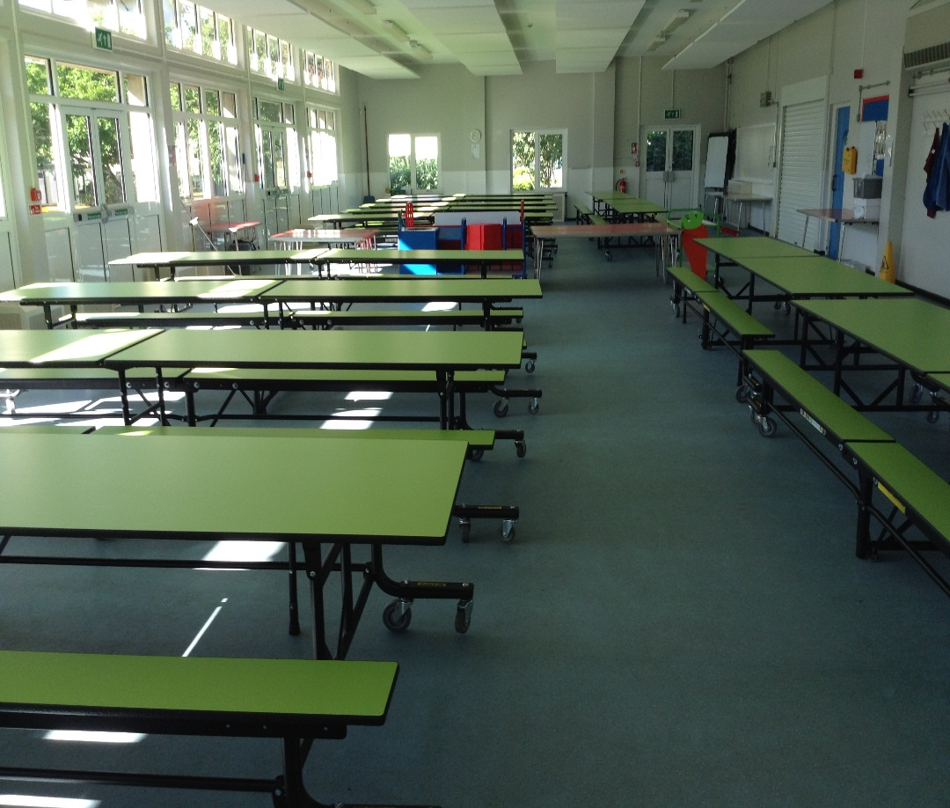
You may use the hall to eat your lunch.

Slide 8
Good luck in Year One!

