Slide 1






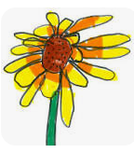






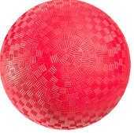

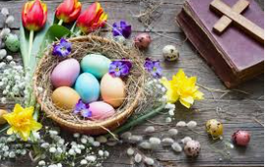
Spring 2
We would love to see what you have been doing! Please show us in your Learning Log books.
Week beginning 10th March
3D shapes
Week beginning 3rd March
Jack and the Beanstalk
Week beginning 17th March
Plants
Observational drawing
Can you draw a picture of a plant? What do you see?
Please return to school on 28 /04/25
Go on a 3D shape hunt. Can you find any shapes that match these? (cylinders, cuboids, cubes, spheres, cones or pyramids?)
Retell the story of Jack and the Beanstalk with your adult. You could act it out using your toys, draw pictures or retell the story in words. Use full sentences when you are speaking.
Challenge –Can you name any of the 3D shapes? Can you name any of the 2D shapes that are on the 3D shapes?
Challenge –Can you label the parts of the plant? Flower, leaf, stem, roots
Mrs Smith
Mrs Pridmore
Miss Meakin
Miss Quick
Mrs Dhadwar
Week beginning 24th March
Pushes and Pulls
Week beginning 31st March
Ball Skills
Week beginning 7th April
Easter
Can you do the challenges in the blue boxes every week?
Explore things that you can push or pull.
Explore how things move on different surfaces and on ramps.
How do some people celebrate Easter?
Mrs Holmes’ and Mrs Coplin’s weekly challenge
Read your reading book and retell the story. Answer questions about the story. | Practise reading and writing the sight words that we send home each week. | Can you say the sounds of the letters that we send home each week?
Challenge –Find some magnets (e.g. fridge magnets, magnetic toys and magnetic construction toys), what happens when you put 2 magnets together? Does the same thing always happen with 2 magnets?
Find a large ball and ask a grown up to play games with you. Practise throwing and catching the ball together. Practise kicking the ball to each other.
Challenge
Can you see any sight words in your book? Can you use them in a sentence?
Challenge
You could read them and write them in words too!
Challenge
Can you make your own story that is similar?

