Slide 1
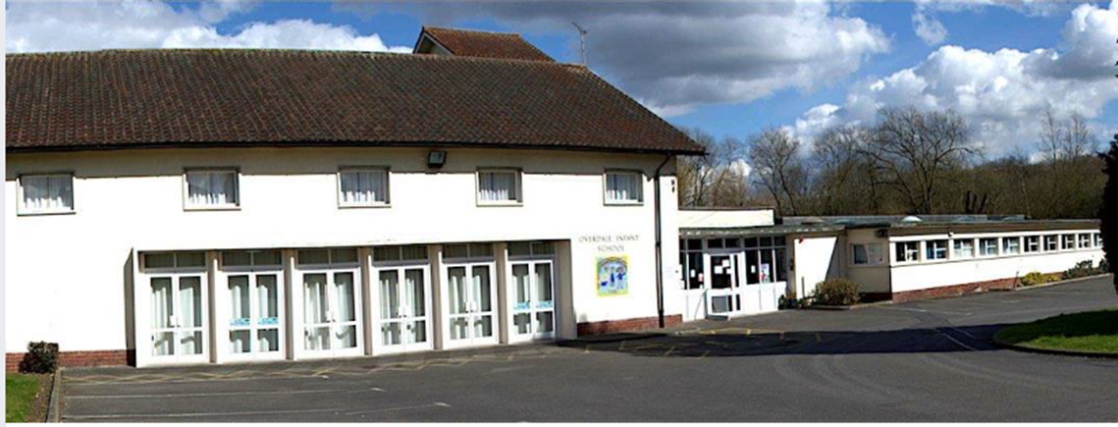
My School Book.

Slide 2
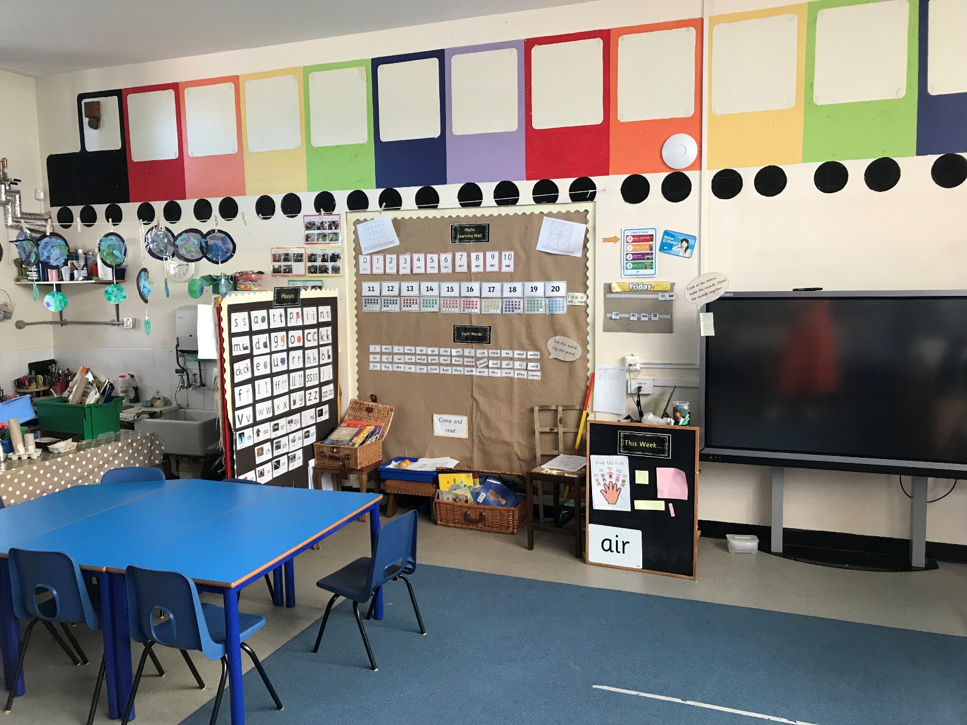
Rainbow 1 will be your new class. It may look like this.

Slide 3
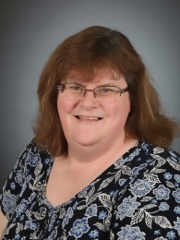
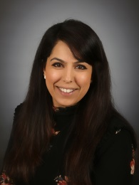
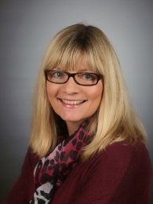
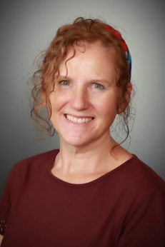
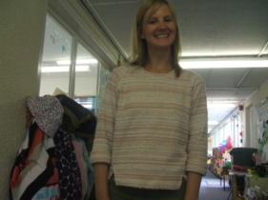
Miss Meakin, Mrs Dhadwar, Mrs Livesey and Mrs Ortega will be your teachers.

Slide 4
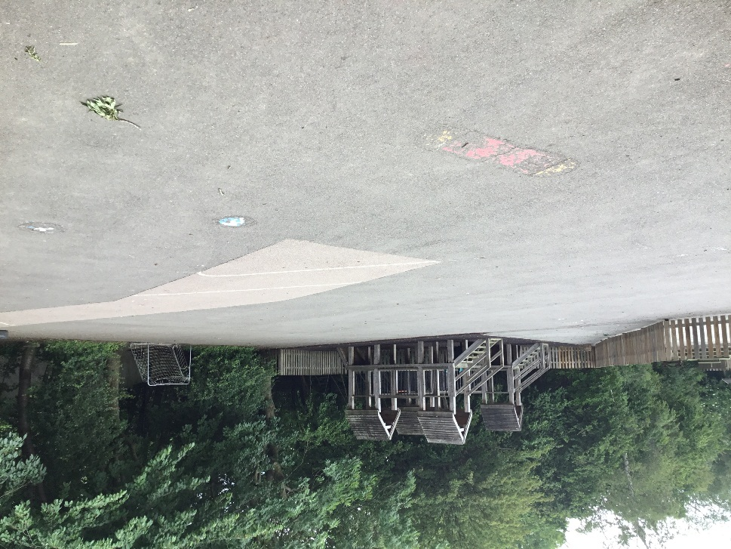
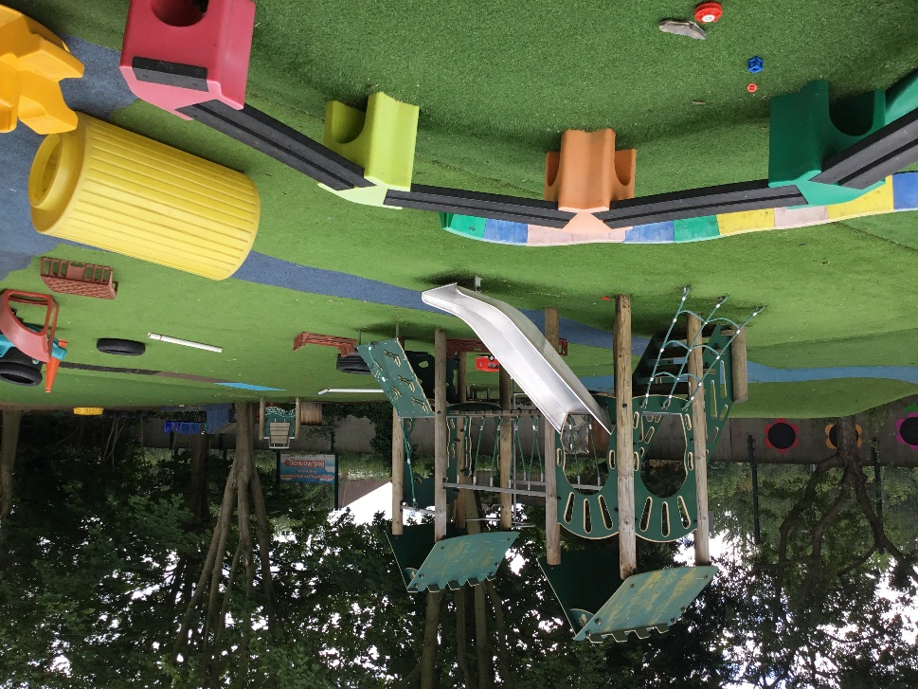
You will use this playground.

Slide 5
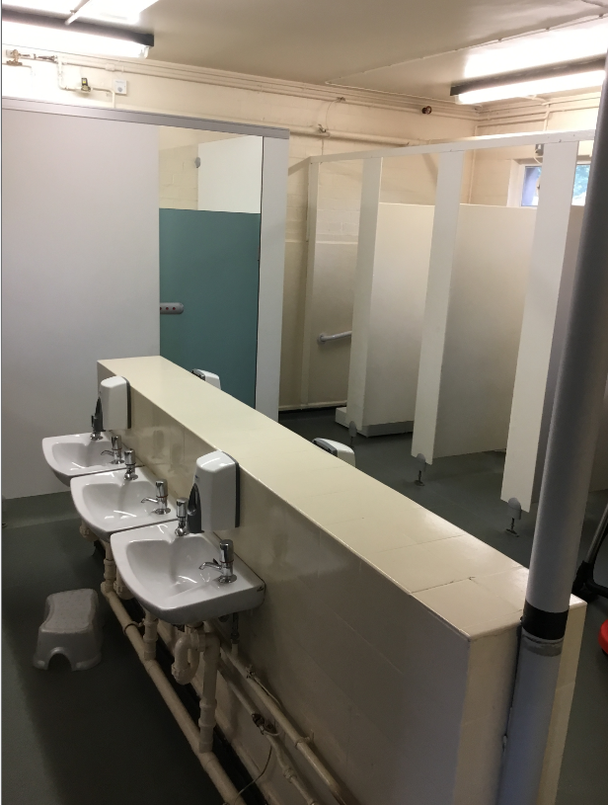
The toilets are next to Rainbow 1.

Slide 6
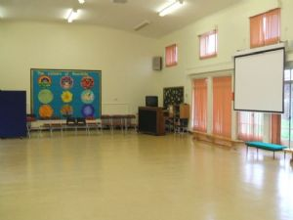
You may use the hall for PE and assemblies.

Slide 7
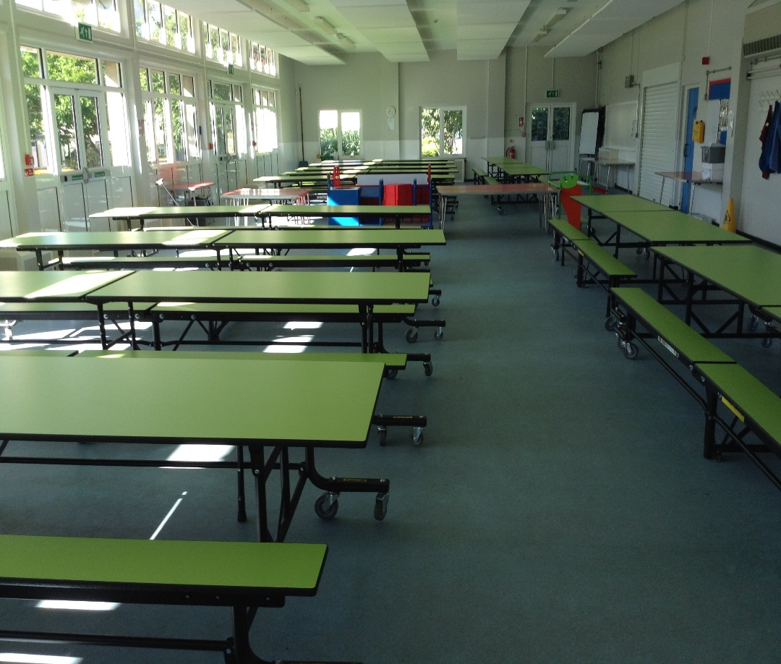
You may use the dining hall to eat your lunch.

Slide 8
Good luck in Rainbows!

